Slide 1
Visual Accessibility with MIT App Inventor
Murielle Dunand

Slide 2

What is MIT App Inventor?

Slide 3
What is low vision?
Central vision loss (not being able to at the center of vision)
Peripheral vision loss (not being able at the edges of vision)
Night blindness (not being able to see in low light)
Blurry or hazy vision
And everything in between!
Notes:
https://www.nei.nih.gov/learn-about-eye-health/eye-conditions-and-diseases/low-vision

Slide 4
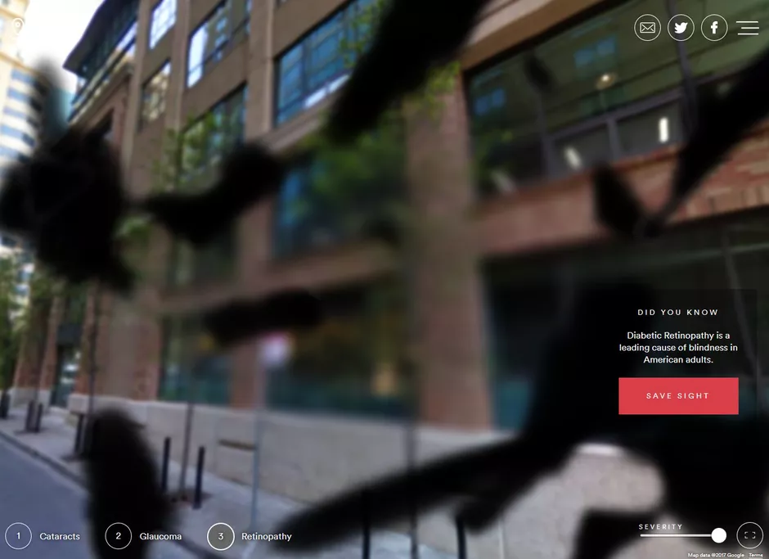
Let’s try it out!
https://simulator.seenow.org/webgl-camera.html
Notes:
Open this link on a mobile device or a computer with a camera.

Slide 5
Discussion
What did you learn about low vision?
How might this affect the use of mobile apps?

Slide 6
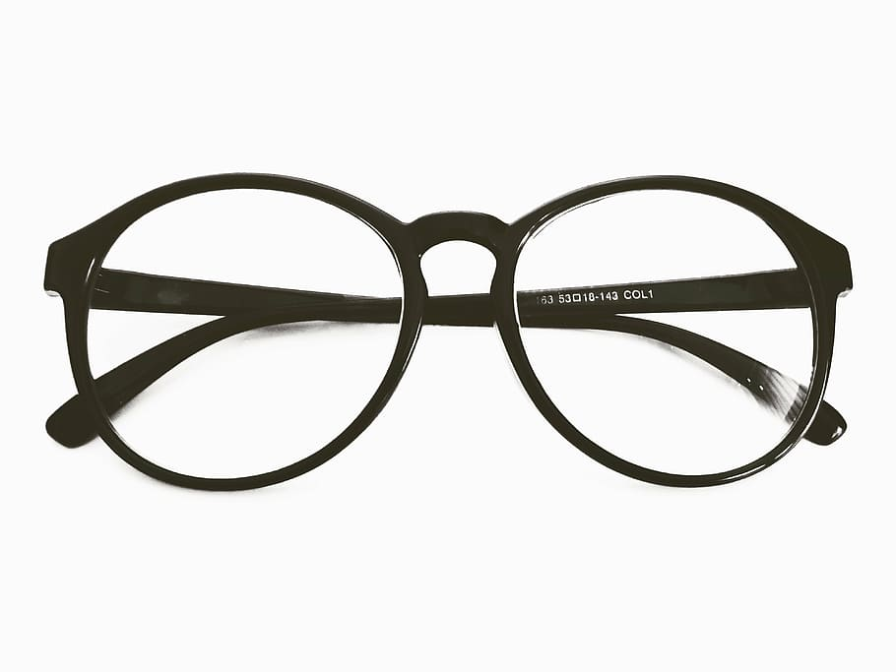
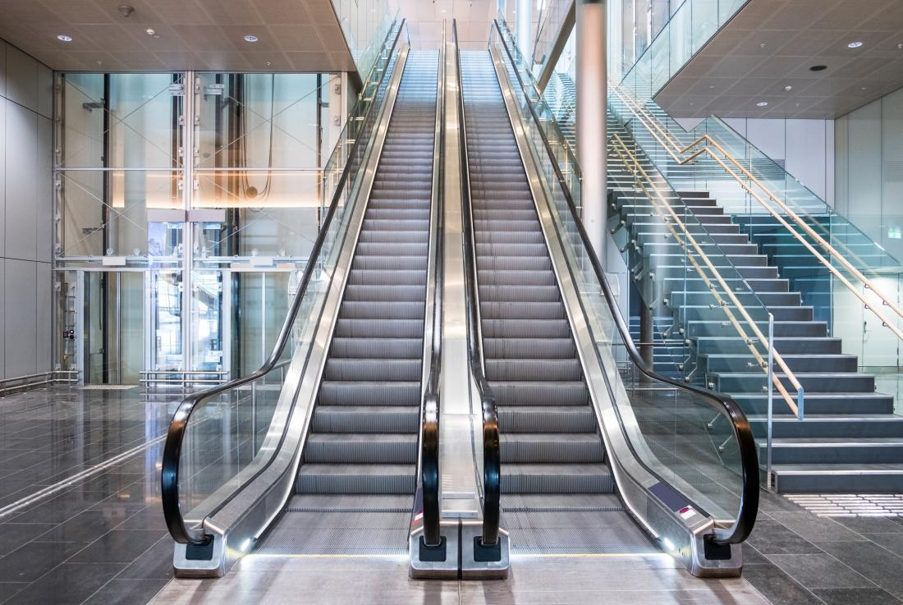

Accessibility Devices
Notes:
What other accessibility devices can you name? Notice that a lot of accessibility devices are also useful for people who don’t “need” them.

Slide 7
App Design
1
2
3
Analysis and Planning
App Development
Testing

Slide 8
Analysis and Planning - Personas
“Personas are the single most powerful design tool that we use. They are the foundation for all subsequent goal-directed design. Personas allow us to see the scope and nature of the design problem.”
— Alan Cooper, software designer, programmer and the “Father of Visual Basic”
Notes:
Split students into groups of around 4 and hand out the persona sheets. Give students 10 minutes to look them over and discuss them.

Slide 9
Persona Analysis
What type of low vision does your persona have?
What are the priorities of your persona?
What parts of mobile apps might they struggle with?
What steps are they taking to improve their experience?

Slide 10
Test out a Completed App
Link to download:
What parts of the app would your persona enjoy?
What parts of the app might they struggle with?
1
2
3
Analysis and Planning
App Development
Testing

Slide 11
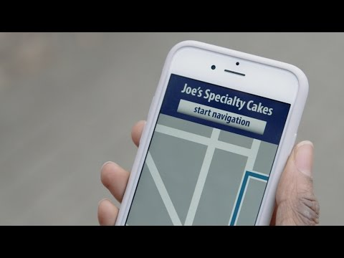
W3C Tips: Contrast

Slide 12
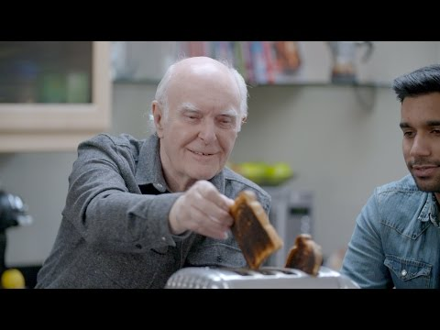
W3C Tips: Text

Slide 13

W3C Tips: Text to Speech

Slide 14

W3C Tips: Sizing

Slide 15
Coin-toss App
Upload the .aia file to App Inventor and try the app in the companion! How would your personas feel about this app? How do you feel about it?

Slide 16
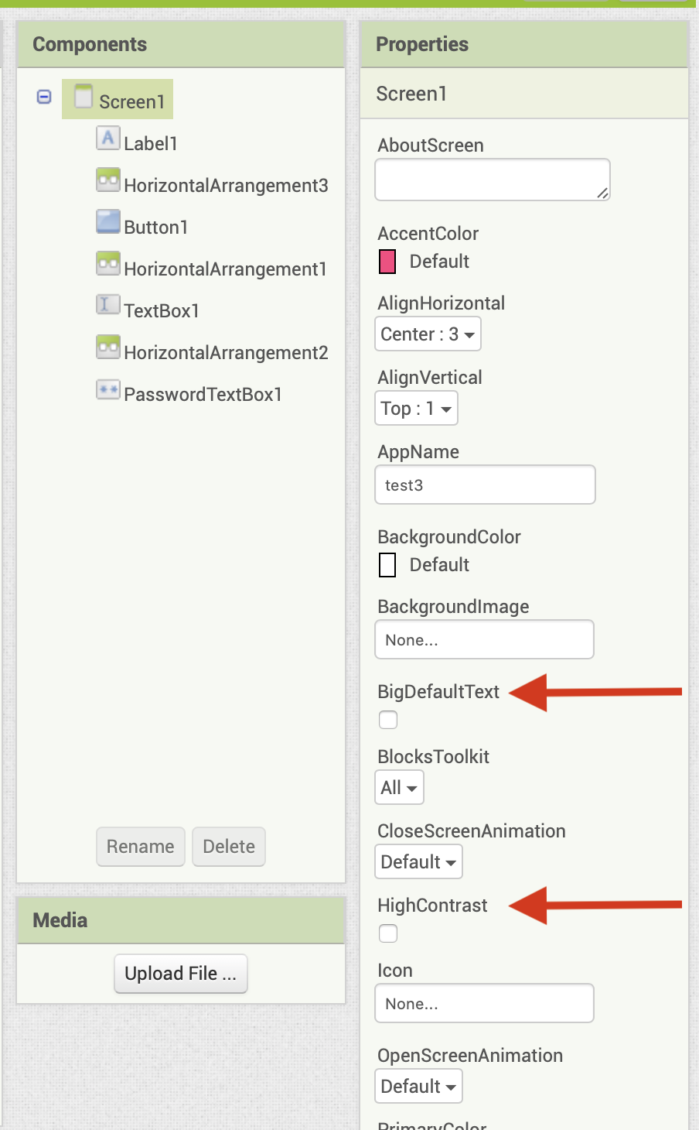
What has been added to App Inventor?
Larger default text option
High Contrast component option
Alternate Text field to images

Slide 17
What can you do?
Consider the people who will be using your apps
Make sure important information is in high contrast
Convey information in multiple ways
Make sure your layout is large and understandable

Slide 18
Improve on the coin-toss app!
Keep in mind the persona you were given
1
2
3
Analysis and Planning
App Development
Testing

Slide 19
Improve on the coin-toss app!
What components did you use?
How do the features reflect the needs of your persona?
What else would you include, given the time?

